Slide 1

JAYPEE UNIVERSITY OF ENGINEERING AND TECHNOLOGY
MINOR PROJECT – 1 (SEM -5)
GROUP NO-49

Slide 2
A Social Media Question And Answers Website
Project Contributors-
Project Mentor-
Rangoli Jaiswal (191B199)
Rishi Neelkanth (191B201)
Pranay Bhatnagar (191B190)
Dr. Neelesh Kumar Jain

Slide 3
Content
Introduction
Feasibility Test
Technology Used
Use Case diagram
ER diagram
Design
Result Conclusion
Project References

Slide 4
Introduction
Have you ever…?
Faced a problem where you have so many questions stuck in your mind but hard to find the solutions.
Difficulty in finding the people of same interest.
Want to use your knowledge for a good cause.
Problem in making new communities on particular topic in a locality or a place .

Slide 5
Introduction
Well , we looked at how we could come up with a solution for this and what we found was -
Create a website which can be used by people of same interest. with a very precise traffic i.e within a certain campus, office or society.
By making a platform where people can form different communities.

Slide 6
Feasibility test
Financial Feasibility-
It is a web application which will be hosted online
Minimal cost will be charged as compared to it’s market competitors.
Technical feasibility-
Each technology which is used is available in the market and can be used by anyone
All the data will be stored in the database.

Slide 7
Technology used
Tools used –VS Code
Frontend – HTML,CSS , JavaScript
Library – React JS, Material UI
Backend - Firebase

Slide 8
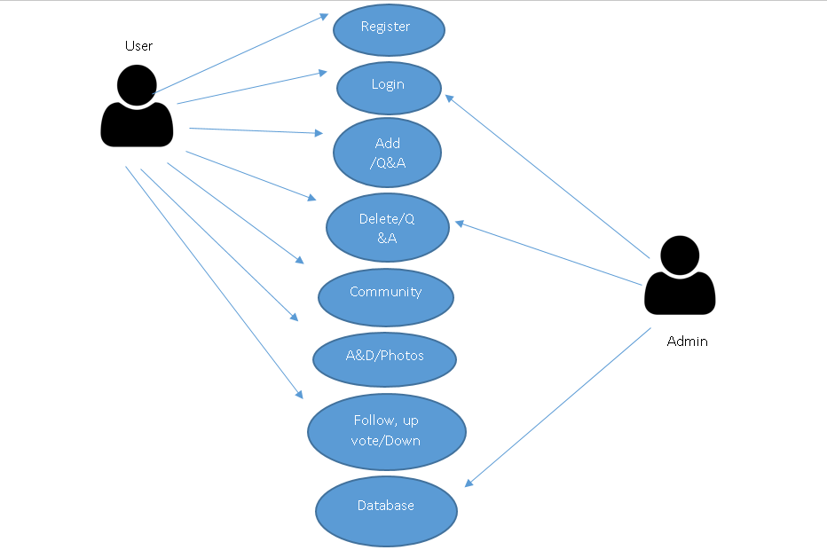
Use Case Diagram

Slide 9
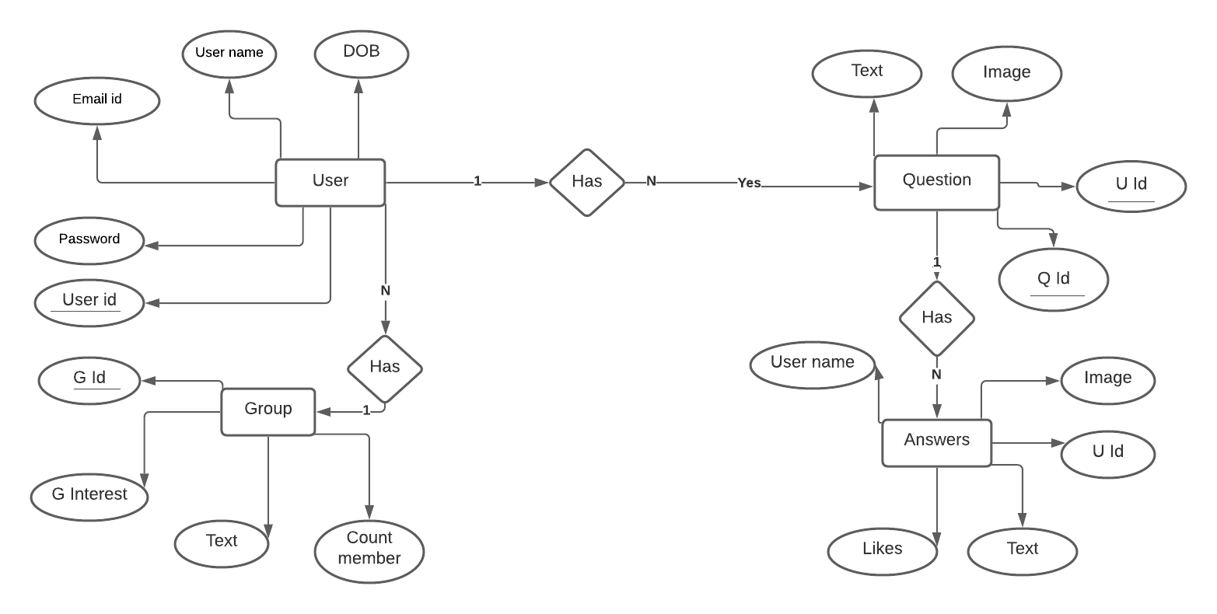
ER Diagram

Slide 10
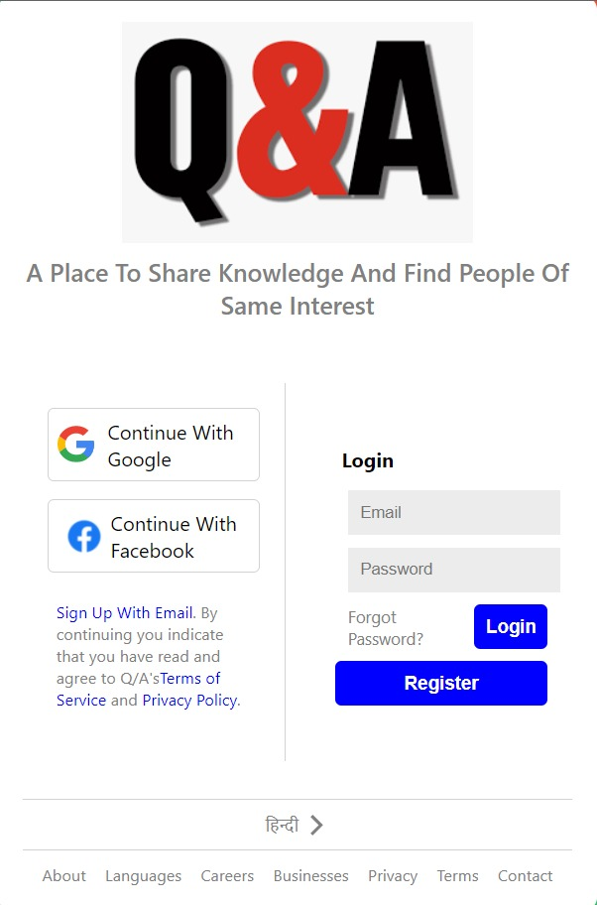
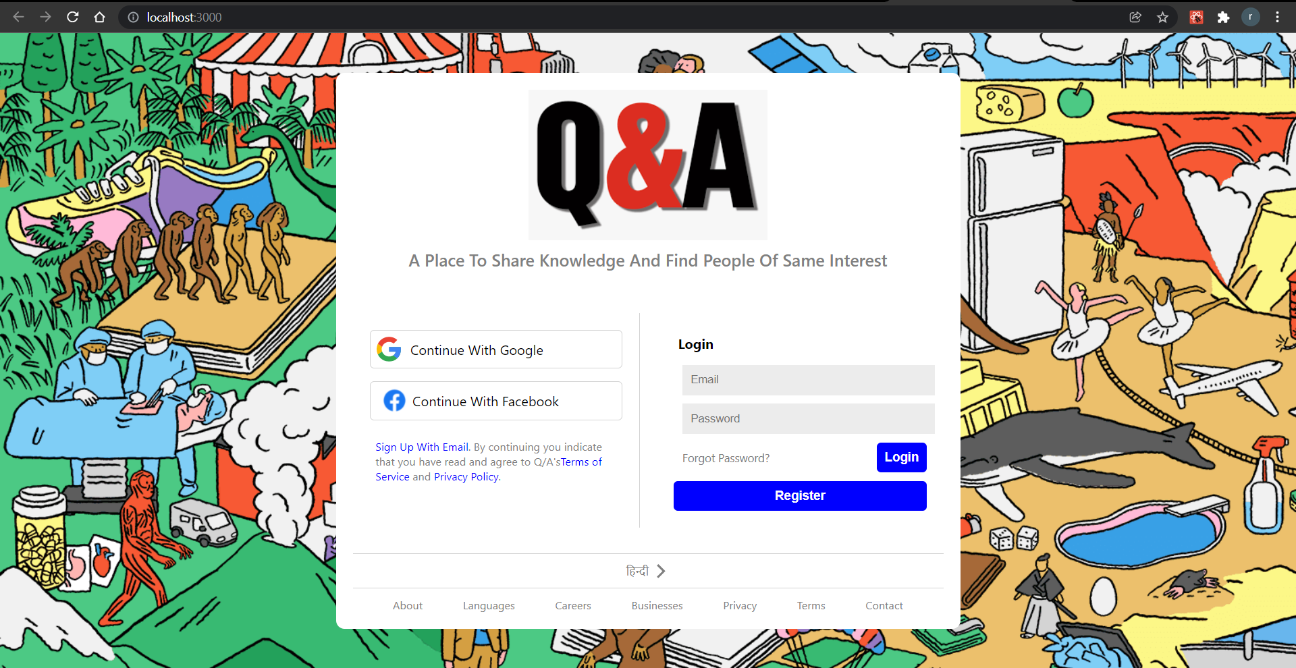
Landing Page
Website view
Responsive view

Slide 11
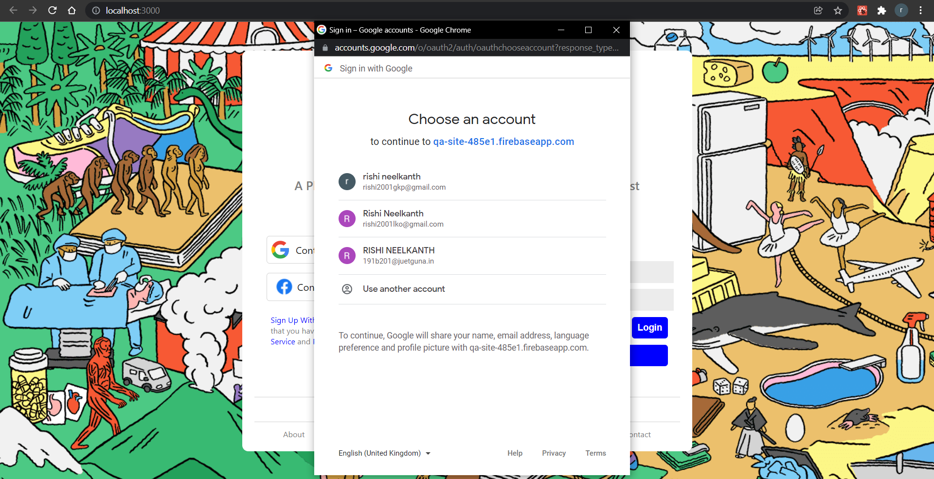
Authentication

Slide 12
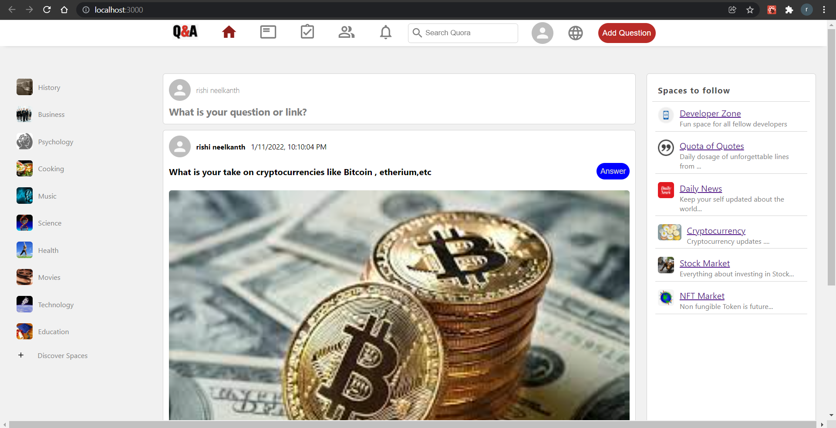
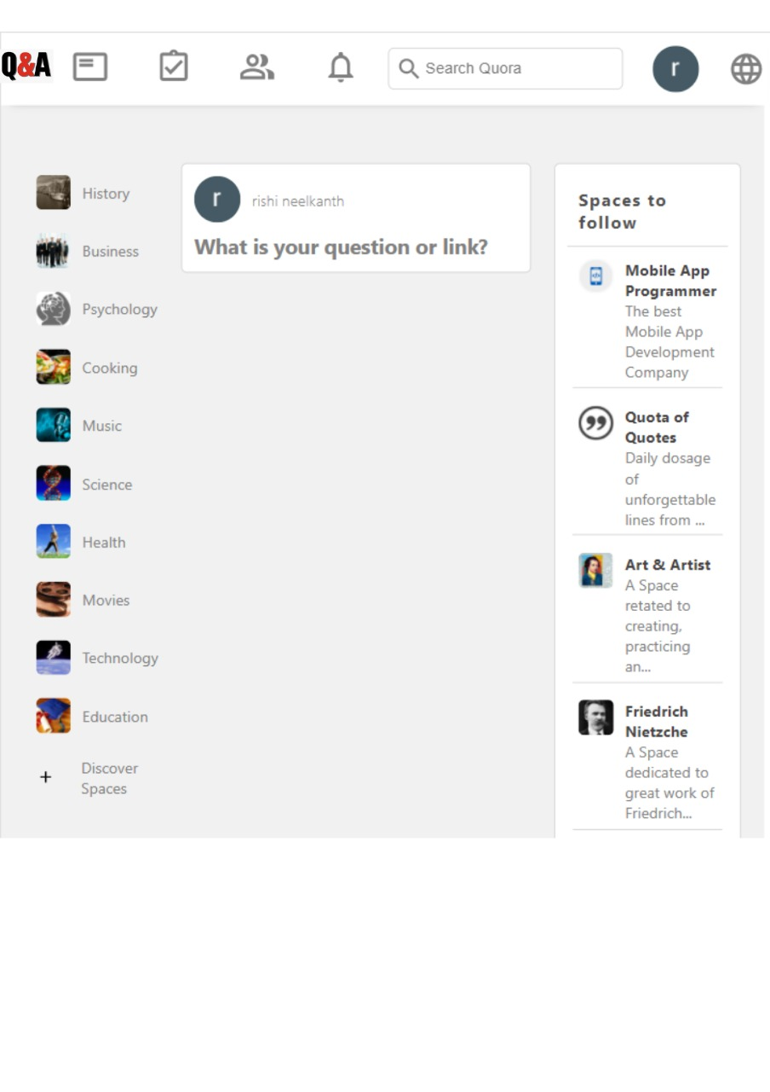
Main Page
Responsive view
Website view

Slide 13
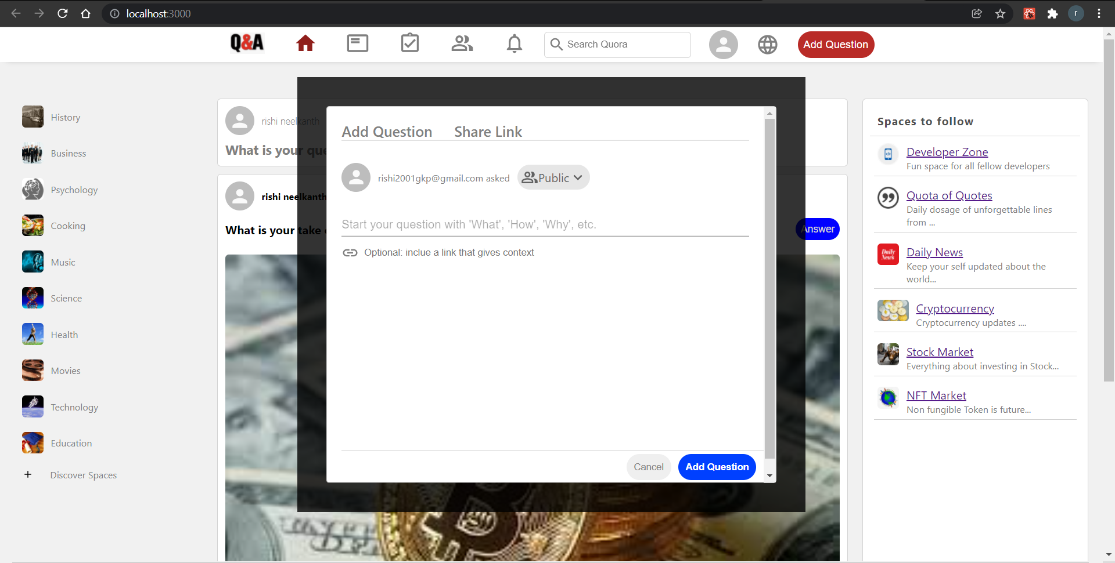
Adding Question

Slide 14
Results and Conclusion
The expected outcome of the website is , it will be fully functional and ready to use in our daily life .
The website will be hosted on the web and students of our college can create account on it and use it for their knowledge and benefit.
People of same interests can create there communities and can exchange their idea using this website.

Slide 15
Contribution
Helping students to interact , discuss and share the latest technology based knowledge among each other . Students of different years can share their experience and can guide each other in a positive direction.

Slide 16
Project references
Google -https://www.geeksforgeeks.org/web-development/
Udemy (web development bootcamp 2020 - angela yu)-https://www.udemy.com/course/the-complete-web-development-bootcamp/
W3school - https://www.w3schools.com/whatis/
Youtube-https://www.youtube.com/c/CodeWithHarry/featured

Slide 17
Any Questions?

Slide 18
Thank You

